Slide 1
Supplier Quality Requirements L3 Communication Systems-West (CSW)

Slide 2
Caveat
This presentation is intended to introduce suppliers to L3 CSW:
Ways of doing business
Customer interfaces
PO and Quality Assurance requirements
The topics covered are an overview only
See the established standard for each specific requirement detail
Contact your responsible Buyers or SQEs with any questions
Contact the Buyer for any PO related questions or issues
Contact the SQE for any QA related issues – Source inspections, QNs, SCARs, etc.

Slide 3
L3 CSW Overview & Summary
L3 Communication Systems-West is a leading provider of networked communication solutions for high-performance intelligence collection, imagery processing, and satellite communications for the Department of Defense (DoD) and other government agencies.
We provide high-data rate, wideband, secure, real-time communication systems for surveillance and reconnaissance.
Our proven world-class solutions and capabilities create high-value, low-risk solutions for use on sea, land, air, and space.
L3's continual focus on Quality, service and performance aims to meet and exceed our customers' expectations.
L3’s success in these areas is highly dependent on our suppliers’ diligence to these very same principles.

Slide 4
Understanding the Purchase Order
The purchase order is the primary document for establishing supplier requirements. It includes:
Product Performance Requirements
Interface and Dimensional Requirements
General Terms and Conditions
Supplier Quality Requirements
The key to being compliant is understanding requirements. The following order of precedence applies to supplier requirements:
Purchase Order (PO), which will impose applicable:
Statement of Work (SOW)
L-3 Drawings and Specifications
SQR-001 (Supplier quality requirements)
Quality System requirements
Workmanship & Commodity Specific Standards
Certificate of Conformance and Data Reporting requirements
Delivery, Pricing, Quantity and Shipping Instructions

Slide 5
PO Tiered Requirements
Purchase orders also impose special provisions for:
General Terms and Conditions
Corporate Terms and Conditions
Defense Priorities and Allocations System (DPAS)
L3 Proprietary Data
Counterfeit Parts
Counterfeit parts requirements are included in both SQR-001 and Corporate T&Cs.
See additional discussion on next page
Invoked Documents:
SQR-001 Supplier Quality Requirements
SQR-XXX Commodity specific requirements
WS-000 Workmanship Standard Instructions
WS-XXX Commodity specific workmanship standards
1000383796 Engineering Drawing and Related Practices applies when invoked in drawing notes or bill of materials

Slide 6
Counterfeit Parts – PO Note
When counterfeit parts are found or are suspected it typically has huge implications across many customers and product lines. L3 places large importance on this topic and has included this requirement on every purchase order.
PO Quote: “Only new and authentic materials are to be used in products delivered to L3. Sub-tier parts must be purchased directly from the original component or equipment manufacturer (OCM/OEM), or though an OCM/OEM franchised distributor. Documentation must be available to authenticate traceability to the OCM/OEM.”
“Independent brokers shall not be used without written consent from L3!”

Slide 7
Doing Business with L3 CSW
Supplier Selection
L3 teams composed of Buyer, Supplier Quality Engineer, and subject matter experts evaluate proposed suppliers.
Suppliers are required to have an active Quality Management System (QMS).
AS9100 preferred
ISO 9001 (or equivalent) minimum is required
A Quality Management System Risk Assessment is completed.
Suppliers will be added to the Approved Source List (ASL) after verification of a suppliers capabilities and risks.
Supplier Scorecards
Scores are a composite rating of Delivery and Quality. These are distributed monthly by SCM to L3’s top 100 suppliers.
If you do not receive monthly, contact SQE to obtain a copy.
Delivery scores are based upon delivery to the agreed contract dates.
Quality scores are based upon acceptance rates per hundred units delivered.
Business Reviews
Performance reviews are held quarterly/periodically with top suppliers.

Slide 8
L3 Drawing types
L3 utilizes the following types of drawings:
Vendor Item Control Drawings
Commercial Off the Shelf (COTS) parts – Parts are identified by L-3 part number and vendor cage code and part number. (L3 CSW workmanship standards do not apply)
Procurement Control Drawings
Modified COTS parts – Parts are identified by L3 part number and vendor cage code and part number, and contain specific modifications to COTS requirements. (L3 CSW workmanship standards apply to the modified requirements only)
Source Control Drawings
L3 defined parts, Produced by a source(s) of supply selected for their expertise. Parts shall be marked with vendor cage code and part number, and L-3 cage code and part number as defined by the drawing. (L3 CSW workmanship standards apply unless otherwise noted on the drawing)
Envelope Drawings
Critical Item Development Specification (CIDS) drawings controlled by redline process using a numerical revision scheme. An envelope drawing discloses the basic technical data and performance. (L3 CSW workmanship standards apply)
CSW Drawings
L3 CSW designed parts. Parts are identified by L3 part number and vendor cage code and part number as defined by the drawing. (L3 CSW workmanship standards apply)

Slide 9
L-3 Inspections
L3 Receiving Inspection Process
All end-item products come through the L3 receiving inspection department
Parts are visually inspected for markings, damage, and workmanship
Paperwork is reviewed against PO and drawing requirements
Any discrepancies are documented on quality notifications (QNs)
L3 Source Inspection
Notify L3 when product will be ready for source inspection
3 weeks notice is required to allow travel arrangements to be made
SQE will typically perform source inspections
SQE may use contracted “Verify” representatives
All acceptance and traceability data should be available for review
Source inspection report showing acceptance of product shall be delivered with any other required certifications and data
Follow this same process when government source inspection is imposed

Slide 10
Quality Notifications
QN’s are L3’s nonconformance/defect reports
QN’s document deficiencies in either paperwork or hardware and can be written at either receiving inspection or the production floor.
QNs are assigned either internal (L3) or external (supplier) responsibility
Supplier QN’s have limited dispositions available:
Rework or similar Condition Corrected
Return to Vendor
Reject not valid
Scrap
Note: Use and Repair dispositions require further elevation for program and/or customer acceptance
Externally caused QNs will be coordinated with suppliers for:
Notification
Paperwork correction
Return to vendor (RTV) for rework or replacement

Slide 11
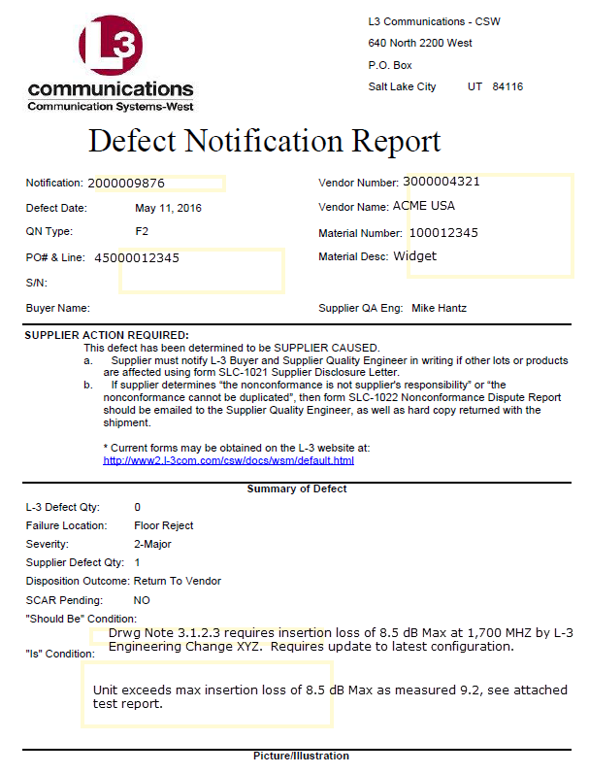
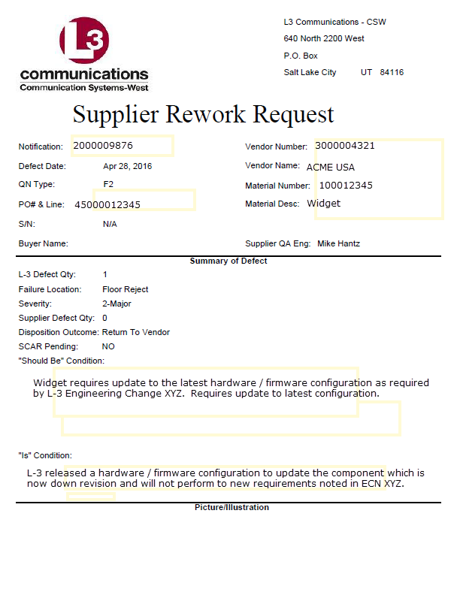
Quality Notifications
Supplier Caused
Not Supplier Caused

Slide 12
Quality Notifications

Slide 13
QN Supplier Responsibilities
Supplier responsibilities include:
Perform containment to determine if similar conditions exist with existing stock or WIP.
Submit form SLC-1021, Supplier Disclosure Letter, if other lots or products are affected with the same condition
Submit form SLC-1022, Nonconformance Dispute Report, if nonconformance is deemed to not be supplier responsibility, or if defect “cannot be duplicated” or verified.
Correct the nonconforming condition and rework parts to drawing and PO requirements. Or replace with new - if nonconforming condition cannot be reworked.
Complete and SCARs in a complete and timely manner

Slide 14
Quality Notifications
Supplier requests for defect consideration must use form SLC-3892, Supplier Nonconformance Request (SNR).
Suppliers do not have MRB authority for items delivered to L3
Supplier has preliminary review authority to Rework or Scrap only
Use and/or Repair dispositions require L3 authorization
The SNR form includes blocks for:
Nonconformance description
Root cause
Corrective & Preventative action(s)
Suggested disposition
Shipment of nonconforming product is not allowed without an approved SNR
SNR copies shall be included with shipment
Requests to scrap L3 owned product also use the SNR form

Slide 15
Supplier Corrective Action Requests (SCARs)
Critical, Major or repeat defects may result in a SCAR
QMS issues and Audit findings also use SCARs to document the conditions and the actions taken to prevent recurrence
Condition(s) needing attention will be described on the SCAR form
Containment actions are due within 7 days, if applicable
Root cause and corrective action plan are due within 30 days
All actions should complete within 90 days
Note: Late or inadequate responses will result in scorecard deductions
These dates are the established guidelines. Changes may be shortened or extended by coordinating with the responsible SQE
Objective evidence of actions taken is required
Follow-up for effectiveness of corrective actions will be evaluated

Slide 16
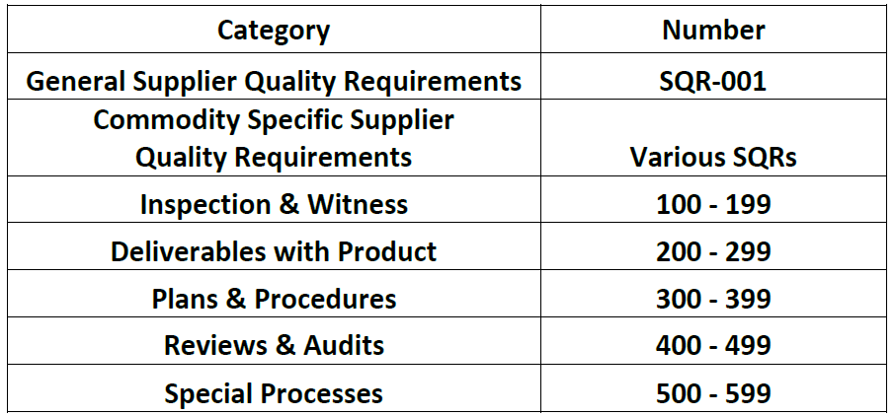
Quality Codes – QC-001
Quality Codes: Quality Codes per QC-001 (available on the L3 Supplier website) are Product / Process / Commodity specific quality requirements called out on PO that are flowed to suppliers and subtier suppliers. It is the responsibility of the supplier to flow requirements to sub-tiers.
Quality Codes are defined as follows:

Slide 17
Workmanship Standards
Workmanship Requirements
The Workmanship Specification Manual (WSM), Workmanship Standards (WS), and Internal Specifications (IS) provide introduction and details of the L3 workmanship standards. These standards are used to supplement drawings, parts lists, and statements of work.
The standards provide direction on class criteria for acceptability to IPC-A-610, IPC/WHMA-620, and J-STD-001 requirements.
Exceptions to these requirements exist for Commercial Off the Shelf (COTS) items purchased to a CSW Vendor Item Control drawing, or other L3 approved assertion of commerciality.
Commodity specific workmanship standards exist for specific product types such as cable harnesses, metal fabricated parts, electromechanical assemblies, circuit card assemblies, cosmetic surface conditions, etc.
See the L3 Supplier website for a complete list of WS standards and links to commodity specific documents

Slide 18
L3 Approved Special Process Suppliers
Special Process Suppliers shall be approved by L3 and be listed on the L3 Special Process Approved Supplier List located on the L3 Supplier Web Portal.
Special Process Suppliers shall pass a L3 audit prior to being utilized for any L3 product.
Special Process Suppliers that are NADCAP certified are only required to have the initial L3 audit, subsequent audits can be waived by providing valid NADCAP certification.
Special Process Suppliers that are not NADCAP certified shall pass aperiodic audit to maintain approval status on the L3 ASL.

